Slide 1
Clustering by passing message between data points
From Science@2007

Slide 2
Differences
K-centers clustering
Random select k points
Very sensitive to the initializations
AP
No need to choose initializations

Slide 3
Aim
Minimize the sum of squared errors between data points and their nearest center point.
The faster the better
The less runs , the better

Slide 4
Message
Responsibility
The accumulated evidence for how well-suited point k is to serve as the exemplar for point i
Available
The accumulated evidence for how appropriate it would be for point I to choose point k as its exemplar

Slide 5

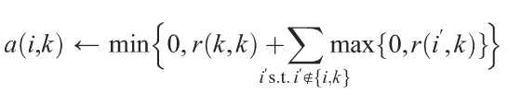


Slide 6
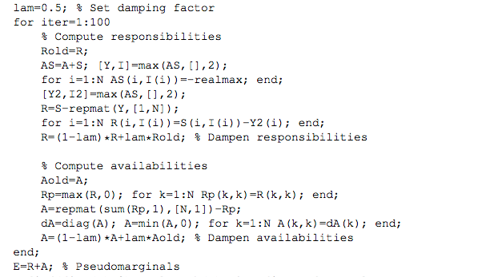
Implement by matlab

